Slide 1

Performance and Power Characterization of Cellular Networks and Mobile Application Optimizations
Junxian Huang
University of Michigan
April 25, 2013
Notes:
OK, let’s start
Today I am very happy to present my work on *title*

Slide 2



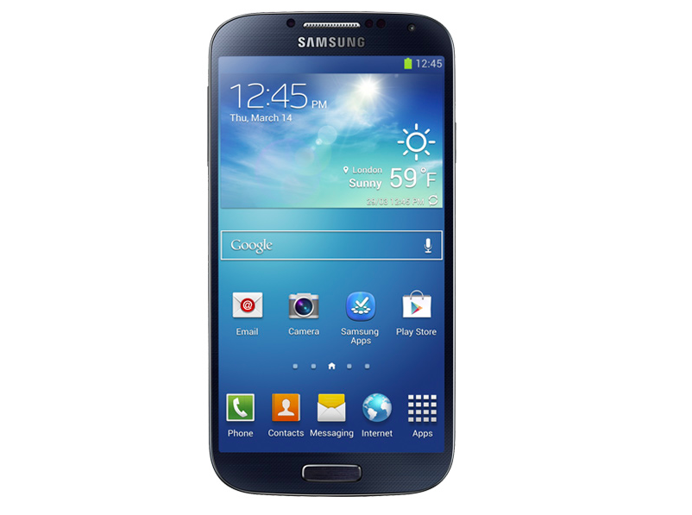





Smartphone Ecosystem
Slow!
Out of battery!
Customer
Smartphone
Vendors
Application
Developers
Mobile
Carriers
Content
Providers
Notes:
Let’s first take a look at the smartphone ecosystem.
Customer is centered by a, b, c, d
Customer wishes to have the applications running on their smartphones be fast and energy efficient.
Smartphone vendors want to optimize the smartphone hardware and OS design to enable good user experience.
Application developers want to attract more users to boost their revenue
Mobile carriers, such as AT&T, Verizon, T-Mobile want to provide good network performance to users, without their network being overloaded and incurring high cost.
Content providers wish to optimize their content design to attract more users as well.
Inside this ecosystem, application performance and power efficiency are very important.

Slide 3
Key Motivations
Performance and power characteristics of cellular networks and smartphone applications are not well studied
especially for the new LTE networks
Many smartphone applications are not well designed with inefficient use of network, radio and power resources
mainly due to the unawareness of the cellular specific characteristics
Notes:
However, performance and power characteristics of cellular networks and smartphone applications are not well studied,
And this is especially true for the new LTE 4G networks
There are some inherent differences between cellular networks and traditional wired or WiFi networks, similarly smartphone OS and applications also differ from their desktop/laptop counterparts.
In the meanwhile, many smartphone applications are making inefficient use of network, radio and power resources, mainly due to the unawareness of the cellular specific characteristics

Slide 4
My Research Goal
To design practical and effective methods to characterize the resource utilization (bandwidth, energy, radio resource…) in cellular networks and improve the mobile application design.
Challenges
Multiple entities involved
The solution needs to be general and practically deployable
Requires evaluation using real cellular workload
Notes:
My research goal is to ..
It is a challenging task as there are multiple entities involved.

Slide 5
Thesis Statement
We devise a suite of systematic methodology and tools to accurately measure the performance and power characteristics of cellular networks (both 3G and the LTE 4G networks) as well as the mobile applications, and to optimize the mobile application design based on such knowledge
Notes:
To meet this research goal, in this study, we …

Slide 6
Roadmap
MobiPerf: characterizing cellular network performance
Anatomizing smartphone application performance
An In-depth Study of LTE
Characterizing Radio Energy Usage
RadioProphet: Optimizing Smartphone Energy and Radio Resource
Notes:
In this talk, we first talk about cellular network performance characterization
Followed by smartphone application performance study
We further present out in-depth study of LTE networks about the effect of Network Protocol and Application Behavior on Performance
Then we will talk about the radio energy characterization and
RadioProphet, the framework to optimize the energy and radio resource usage in cellular networks.

Slide 7
Roadmap
MobiPerf: characterizing cellular network performance
Anatomizing smartphone application performance
An In-depth Study of LTE
Characterizing Radio Energy Usage
RadioProphet: Optimizing Smartphone Energy and Radio Resource
Notes:
We will first talk about MobiPerf, a measurement platform to characterize cellular network performance

Slide 8

Design Goals of MobiPerf
Measure most relevant network characteristics of cellular networks
Measurement results not be affected by any external factors
Attract a large number of users covering different carriers and geographical regions
Benefit the research community in terms of both tool and data
Notes:
We design MobiPerf to
1 measure the most relevant network characteristics of cellular networks.
2 We also don’t want the measurement results to be affected by any external factors, such as the delay introduced by the Internet path
3 We also hope MobiPerf to attract a larger number of users using different carriers covering different geographical regions
4 and to benefit the research community in terms of both tool and data

Slide 9
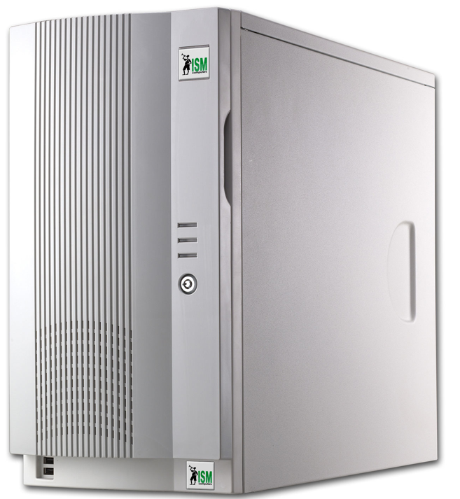
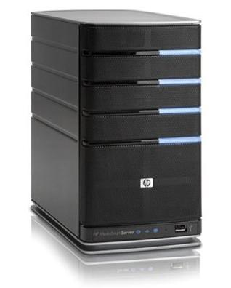
Cellular Network Metrics
DNS (domain resolution)
Local DNS response time
TCP
Common TCP metrics: downlink/uplink throughput, round-trip time (RTT), packet loss rate, etc.
For TCP throughput test, we choose the closest nodes among the 120+ global M-Lab nodes
Local DNS server
Smartphone
Web server
Notes:
MobiPerf measures the most important network metrics including
DNS related and TCP related metrics
For TCP metrics, we measure downlink and uplink throughput, RTT and packet loss rate.
For throughput test, in order to minimize the effect of the Internet path, MobiPerf will choose the closest nodes among the 120+ M-Lab nodes distributed globally

Slide 10

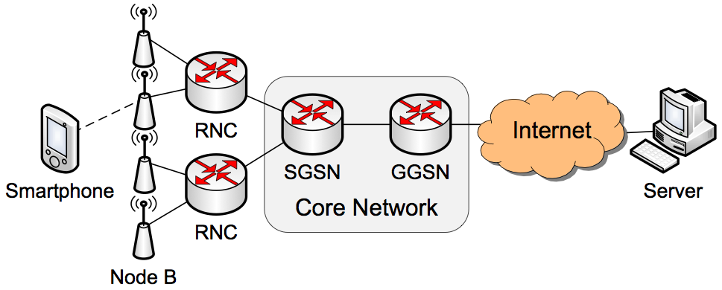
Cellular Network Metrics
Ping (Impact of diverse Internet servers)
Ping A: Ping latency to the first responsive IP hop
Ping B: Ping latency to landmark servers at diverse Internet locations
Ping A
Ping B
Notes:
MobiPerf also measures Ping latency to different hops in the cellular networks.
This graph illustrates the infrastructure of 3G networks.
GGSN is the first IP hop along the network path, and Ping A measures the delay inside the cellular.
Ping B is the end-to-end delay between client and internet host and by comparing Ping A and Ping B, we are able to know whether cellular network delay is dominant.

Slide 11
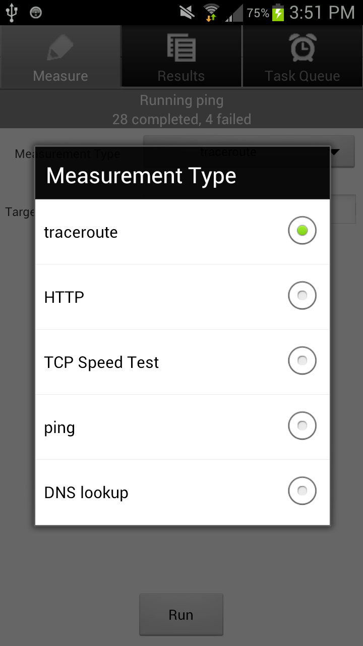

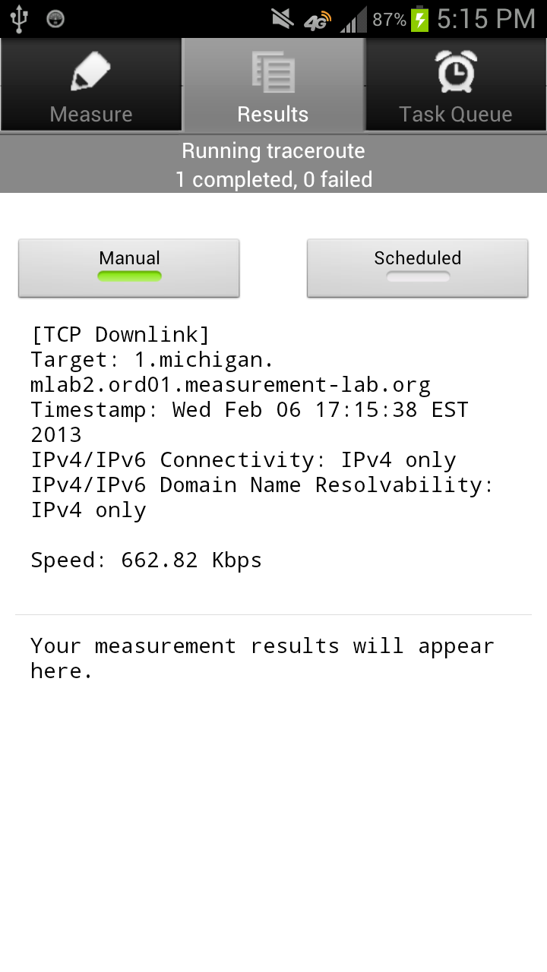
http://mobiperf.com
Notes:
MobiPerf has gone through multiple versions with functionality and UI improvements.
This is what MobiPerf looks like now

Slide 12
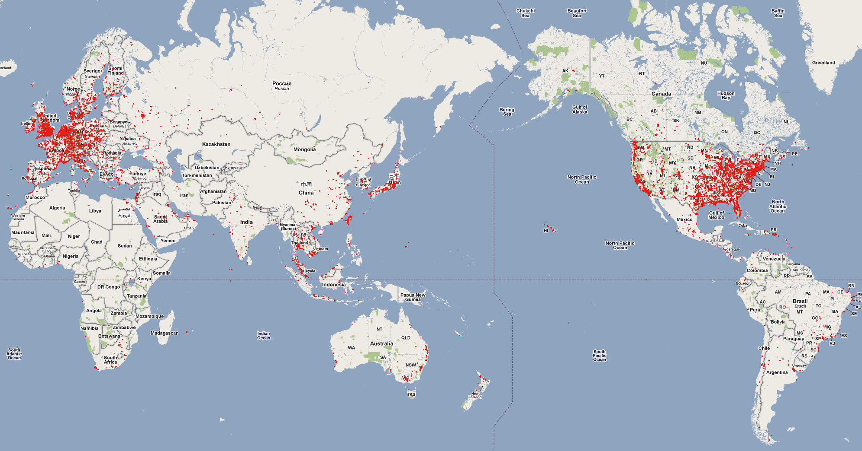
Coverage of MobiPerf Data
70K+ users 200K+ runs 84 carriers 147 countries
Notes:
MobiPerf has helped us collect data from over 70K users from 140+ countries covering 84 carriers.
It is a useful and representative data set.

Slide 13
MobiPerf Benefits the Research Community
Open source
https://github.com/Mobiperf/MobiPerf
Other researchers can easily add modular measurement tasks into MobiPerf tool
Open data
gs://openmobiledata_public (Google storage)
Recognition
In 2011, People's Choice Award and Open Internet App Reward in the FCC Open Internet Apps Challenge
Notes:
We also made available the source code and data from MobiPerf.
And MobiPerf has won People’s Choice Award and Open Internet App Reward in the FCC’s Open Internet Apps Challenge

Slide 14
Roadmap
MobiPerf: characterizing cellular network performance
Anatomizing smartphone application performance
An In-depth Study of LTE
Characterizing Radio Energy Usage
RadioProphet: Optimizing Smartphone Energy and Radio Resource
Notes:
With the knowledge of cellular network performance obtained from MobiPerf data set,
we anatomize the smartphone application performance to identify its bottlenecks.

Slide 15
Smartphone web browsing is complicated
DNS lookup
Content customization
1
Client configuration
Server configuration
Local DNS server
HTML rendering & JavaScript execution
Server processing delay
5
3
Network condition
2
4
TCP handshake
TCP data transfer
Smartphone
Web server
Notes:
Web browsing is one of the most important application on smartphones.
However, it is not straightforward to quantitatively measure and break down web browsing performance.
1 2 3 4 5
The web browsing performance is affected by client configuration, network condition, server configuration and content customization.

Slide 16
Key challenges of web performance analysis
Multiple factors have joint impact
Network condition
Client settings
Server configurations
Content differences
Lack of low-level information and access
No visibility into link layer
Difficult to instrument client OS and application
Notes:
To summarize, the key challenges of web browsing performance analysis is that
Multiple factors mentioned earlier have joint impact.
We are also in lack of low-level information,
such as that there is no visibility into link layer
And it is difficult to instrument client OS and application, unlike desktop environments.

Slide 17
How to isolate impact of individual factor?
Vary one factor at a time
Network condition
Simulate cellular network with WiFi via iptables
Client settings
Control TCP concurrency
Server configurations
Change compression mode and server parallelism
Content difference
Host static website snapshots locally
Notes:
In order to isolate the impact of individual factors, we choose to vary one factor at a time while fixing all others.
Given that cellular network condition is highly variable, we use WiFi network to simulate cellular via iptables by adding additional delay and packet loss,
because WiFi performance is more stable
In terms of client settings, we are able to control the TCP concurrency settings
We also change the server’s configurations to control the compression mode and server allowed parallelism.
We also mirror the top 20 popular website and host their static snapshots locally to cope with their dynamic contents

Slide 18
How to identify performance bottlenecks?
TCP flow analysis technique to break down page loading time
DNS lookup time
TCP handshake time
TCP idle time
TCP transfer time
T₁
index.html
logo.png
t_{a}
t_{b}
T₂
Time
T
Notes:
In order to identify the performance bottlenecks, we break down the page loading time into 4 components.
DNS lookup time shows the total time of domain resolutions inside a web session.
TCP handshake time is the total time to establish all required connections.
TCP idling time mainly comes from client rendering HTML contents and execute JavaScript
TCP transfer time is the time to download web objects.
However, there may be multiple connections within each web transaction, so we use a TCP flow analysis technique to normalize the 4 components.
In the figure, the web session contains two object, index.html and logo.png embedded in the index.
Ta and tb are the two DNS lookup time in the two flows.
T1 and T2 are the flow duration of two flows.
T is the actual page loading time.
We normalize the new DNS time using the formula here

Slide 19
Web browsing breakdown
Web browsing performance bottlenecks
Client execution (TCP idle time)
Network transfer (TCP transfer time)
TCP transfer time
TCP idle time
Page loading time (seconds)
Notes:
We then breakdown the web browsing performance into four components using the aforementioned analysis methodology.
We measure the web browsing performance of 5 smartphones and 20 most popular websites.
Here we only show the best and worst performance of all smartphones and two representative websites,
one is a very simple website, and the other is a more complex and content-rich website.
1 we can observe that TCP transfer time and TCP idle time are the two major components in the page loading time
As expected, complex website takes higher TCP transfer time to download and more TCP idle time to render.
2 comparing the two devices, the TCP transfer time difference is smaller than that of the TCP idle time for the same website, which indicates that
the HTML rendering and JavaScript execution speed difference is the main reason for two smartphone having different page loading time in the same network condition.

Slide 20
Lessons from web browsing performance study
Performance bottlenecks of web browsing
Client execution
Data download (less for LTE)
Higher concurrency significantly improves performance
Compression is usually helpful
Content customization is beneficial
Data URL scheme
Minification
Redirection reduction
Notes:
We summarize the main lessons we learnt from the web browsing performance study.
And in the thesis, we also talked about other types of applications on smartphones, such as video and VoIP.
For web browsing, we have observed that client execution and data download are the two major performance bottlenecks for 3G networks.
And we also studied the web browsing performance for LTE networks and the data download bottleneck has become less critical due to LTE’s high bandwidth.
We also observe that high TCP concurrency and compressing web contents helps improves web performance.
In addition, we find that content customization and optimization techniques such as data URL scheme, minification and redirection reduction is beneficial for improving web performance as well.

Slide 21
Roadmap
MobiPerf: characterizing cellular network performance
Anatomizing smartphone application performance
An In-depth Study of LTE
Characterizing Radio Energy Usage
RadioProphet: Optimizing Smartphone Energy and Radio Resource
Notes:
Following the previous discussion on cellular network performance and smartphone application performance,
We present our in-depth study of LTE networks to understand the Effect of Network Protocol and Application Behavior on Performance with a large-scale real-world data set.

Slide 22

LTE is New, Requires Exploration
4G LTE (Long Term Evolution) is future trend
Initiated by 3GPP in 2004
100Mbps DL, 50Mbps UL, <5ms latency
Entered commercial markets in 2009 and now available in more than 10 countries
Notes:
We further study LTE network characteristics
.LTE stands for Long Term Evolution. Back in 2004, 4G LTE is initiated by 3GPP.
The design goal for LTE is quite promising, with 100Mbps downlink, 50Mbps uplink and <5ms user-plane latency.
Since 2009, LTE has entered commercial markets and now available in more than 10 countries, with more countries ongoing or planned.
It is anticipated to become the first truly global mobile phone standard and is a future trend

Slide 23
Motivations
LTE has not been extensively studied empirically in a commercial network setting
Study how network resources are utilized across different protocol layers for real users
Evaluate the benefits of increased bandwidth for mobile applications and essential network protocols to identify their limitations
Notes:
Given that LTE has only entered commercial markets a few years ago, it has not been extensively studied empirically in a deployed commercial network setting.
We wish to study how network resources are utilized across different protocol layers for real users
And evaluate the benefits of bandwidth improvement for mobile applications and essential network protocols to identify their limitations.

Slide 24
LTE network topology of the studied carrier
Notes:
We start by introducing the LTE network topology.
UE or user equipment is connected with the eNB in the Radio Access Network via wireless signals.
The traffic then goes through the monitor, gateways, proxy and firewalls in the core network, before entering Internet.

Slide 25
LTE network topology of the studied carrier
Data collection point
Notes:
And our data set is collected at the monitor side.

Slide 26
Data set studied
Data set statistics
Covering a fixed set of 22 eNBs at a large metropolitan area in the U.S.
Over 300,000 users
3.8 billion packets, corresponding to 3 TB of LTE traffic
Collected over 10 consecutive days
Data contents: packet header trace consisting of
IP and transport-layer headers
A 64-bit timestamp for each packet
No payload data is captured except for headers of HTTP
Notes:
The data set covers a fixed set of 22 eNBs at a large metropolitan area in the U.S. with over 300,000 subscribers.
There are 3.8 billion packets corresponding to 3TB of LTE traffic and the data set is collected over 10 consecutive days.
The data includes IP and TCP/UDP packet header and HTTP header, etc.

Slide 27
Queueing delay
Large buffers in the LTE networks may cause high queuing delays
Bytes in flight – unacknowledged TCP bytes
Notes:
However, we notice one problem for LTE networks when transferring large-size objects.
TCP uses a window to allow sending bytes without requiring acknowledgements of all previous bytes.
Such unacknowledged TCP bytes can be called bytes in flight.
In LTE networks, there are large buffers that can hold bytes in flight and in this figure, we can observe that when the bytes in flight grows, the RTT significantly increases.

Slide 28
High queueing delay causes unexpected TCP behavior
When one LTE user is downloading data …
Each dot corresponds to either a data packet or an ACK packet
Notes:
Such high queueing delay may cause unexpected TCP behavior.
Here is one example. This figure shows the TCP sequence number vs. time plot of an LTE user downloading a music file.
Each dot in the figure corresponds to either a data packet or an ACK packet.

Slide 29
High queueing delay causes unexpected TCP behavior
bytes in flight growing
Notes:
The vertical gap between data and ACK curve indicates the bytes in flight
And we clearly see that the bytes in flight is growing as the downloading proceeds.

Slide 30
High queueing delay causes unexpected TCP behavior
Packet loss
Notes:
We observe a packet loss at time 1 second

Slide 31
High queueing delay causes unexpected TCP behavior
Fast retransmission allows TCP to directly send the lost segment
to the receiver possibly preventing retransmission timeout
Fast retransmission
Notes:
Then based on TCP, when the sender detects that there is a packet loss,
Fast retransmission would be triggered which allows it to directly send the lost segment to the receiver possibly preventing retransmission timeout.

Slide 32
High queueing delay causes unexpected TCP behavior
TCP uses RTT estimate to update retransmission timeout (RTO)
However, TCP does not update RTO based on duplicate ACKs
RTT: 262ms
RTO: 290ms
Duplicate ACKs
Notes:
TCP uses RTT estimate to update retransmission timeout (RTO),
In this example, when the lost segment is retransmitted, RTT is 262ms and RTO is 290ms.
However, TCP does not update RTO based on duplicate ACKs.
Notice that the duplicate ACKs are generated by the reception of the data packets sent AFTER the lost segment.

Slide 33
High queueing delay causes unexpected TCP behavior
Retransmission timeout happens, the congestion window drops to 1 segment, triggering slow start, hurting TCP performance
RTT: 356ms
RTO: 290ms
RTT > RTO, timeout!
Slow start
Notes:
However, given that the RTT is growing and by the time the ACK of the retransmitted segment is back,
RTT has increased to 356ms, while RTO is not updated.
Since RTT is larger than RTO now, there is unexpected retransmission timeout.
It is called unexpected because the purpose of fast retransmission is to prevent such timeout to happen.
After timeout, the congestion window would drop to 1 segment size, triggering slow start, which hurt TCP performance.
----- Meeting Notes (4/22/13 22:21) -----
add formula how RTO is calculated

Slide 34
Prevalence of the slow-start problem
For all the large TCP flows with ≥ 1 packet loss, 20% of them suffer from the slow start problem, which consists of 12.3 % of all large TCP flows
In one case, a 3-minute flow even experience 50 slow starts, resulting in an average throughput of only 2.8Mbps, while the estimated bandwidth actually larger than 10Mbps
Notes:
Using our flow analysis techniques, we study the prevalence of such problems in our data set.
For all the large TCP flows with >= 1 packet loss, about 20% of them have such slow start problem,
which is 12.3% of all large TCP flows.
In one case, a 3-minute flow have 50 slow starts, and the resulted throughput is only 2.8Mbps while the actual bandwidth is > 10Mbps.
In the thesis, we talked about different possible methods to mitigate this problem.

Slide 35
Passive bandwidth estimation algorithm based on server-side traces
Import for understanding the network utilization efficiency of mobile applications
Active probing methods do not apply since the network condition is highly variable and it is impossible to launch measurement for all users
Notes:
In order to understand the network usage efficiency of mobile applications in LTE networks, we first need to know the available bandwidth.
Given our data set, we have to devise a passive bandwidth estimation algorithm based on server-side traces, because the existing active probing methods do not apply as the network condition is highly variable and it is impossible to launch measurement for all users.

Slide 36
Bandwidth estimation algorithm
Typical TCP data transfer
Notes:
I will briefly describe our bandwidth estimation algorithm using this figure illustrating a typical TCP data transfer.
P1 to Pn are data packets sent from server to UE
T1 to t7 are packet timestamps in each entity’s local clock.

Slide 37
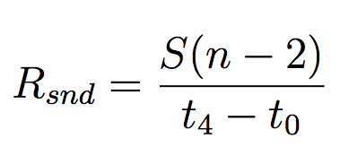
Bandwidth estimation algorithm
Assume packet size is S,
sending rate between
t₀ and t₄ is
Notes:
Assume the packet size is S, the sending rate from the monitor to the UE between t0 and t4 is given in this formula,
Since there are n-2 packets.

Slide 38
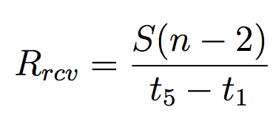
Bandwidth estimation algorithm
From UE’s perspective,
the receiving rate for
these n − 2 packets is
Notes:
From the UE’s perspective, the receiving rate for these n-2 packets is S(n-2) devided by t5 – t1, assuming there is not out-of-order transfer and no packet loss.

Slide 39
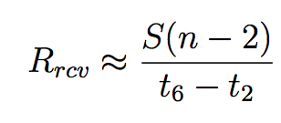
Bandwidth estimation algorithm
Typically, t₂ is very close
to t₁ and similarly for
t₅ and t₆
Notes:
Using controlled experiments, we observe that the gap between receiver receiving a data packet and sending an ACK is less than 1ms, which is negligible.
So the receiving rate is close to S(n-2) divided by t6-t2

Slide 40
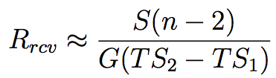
Bandwidth estimation algorithm
We use TCP Timestamps
option to calculate
t₆ − t₂ (G is a constant
that can be inferred for
each client)
93% of the TCP flows have TCP Timestamps option enabled
Notes:
From the monitor’s side, we don’t know that t6 and t2 are.
However, we can use TCP timestamps option to calculate t6-t2 with the help of G constant.
Basically, t6-t2 = G(TS2 – TS1) while TS1 and TS2 are the values that can be read from TCP headers at the monitor side.
We also check in our data set and observe that 93% of the TCP flows have TCP Timestamps option enabled making our algorithm applicable.

Slide 41
Bandwidth estimation algorithm
Using a sliding window, we obtain pairs of (R_{snd} , R_{rcv} )
If a list of conditions about R_{snd} and TCP flow characteristics are met, R_{rcv} is the estimated bandwidth
We use local controlled experiments to validate, the error rate is < 8%
Using this algorithm, we are able to predict the available bandwidth for over 90% of the large downlink flows
Notes:
Given the ways to calculate sending rate and receiving rate, we use a sliding window to obtain pairs of Rsnd and Rrcv.
If a list of conditions, such as no out-of-order transfers, no packet loss, is met, the receiving rate is the estimated bandwidth.
We use local controlled experiments to validate our algorithm and observe < 8% error rate.
We also analyze the applicability of our algorithm, and we are able to apply the algorithm to predict for over 90% of all large downlink flows.

Slide 42
Bandwidth utilization by real applications in LTE
Median of bandwidth utilization ratio is 20%, and on average, the utilization ratio is 35%
For 71% of the large flows, the bandwidth utilization ratio is below 50%
Reasons for underutilization
Small object size
Insufficient receiver buffer
Inefficient TCP behaviors
Notes:
To summarize our findings about the network utilization efficiency,
We observe that the median bandwidth utilization ratio is only 20%, with the average ratio 35%.
Also, for 71% of the large flows, the bandwidth utilization ratio is below one half.
We explored the reasons for such underutilization
Some of these underutilization is due to the small object size, while some are due to various application design problems, such as insufficient receiver buffer size, and inefficient TCP behaviors

Slide 43
Bandwidth estimation timeline for two sample large TCP flows
LTE network has highly varying available bandwidth
Notes:
This figure show the time series of estimated available bandwidth of two sample large TCP flows.
The available bandwidth has very high variation.

Slide 44
LTE bandwidth variability, RTT and TCP performance
Under small RTTs, TCP can utilize over 95% of the varying available bandwidth
When RTT exceeds 400∼600ms, the utilization ratio drops to below 50%
For the same RTT, higher variation leads to lower utilization
Long RTTs can degrade TCP performance in the LTE networks
Notes:
We use controlled experiments to study how TCP is capable to utilizing the available bandwidth in such highly varying conditions.
We observe that when RTT is small, TCP is able to use over 95% of the varying available bandwidth.
However, when RTT exceeds 400~600ms, the utilization ratio drops to below 50%.
Also, for the same RTT, higher variation leads to lower utilization.
This indicates that long RTTs, for example resulted by the queueing delay, in LTE network can degrade TCP performance.

Slide 45
Roadmap
MobiPerf: characterizing cellular network performance
Anatomizing smartphone application performance
An In-depth Study of LTE
Characterizing Radio Energy Usage
RadioProphet: Optimizing Smartphone Energy and Radio Resource
Notes:
Besides network performance, energy efficiency is another important aspect for cellular networks and mobile applications.
In order to characterize the radio energy usage of cellular networks and mobile application,
we first need to understand the mechanisms of the radio interface that result in different power levels

Slide 46
RRC state transitions in LTE
Notes:
we illustrate the LTE state machine and state transition procedures in this slide
There are two RRC states in LTE network, RRC_CONNECTED and RRC_IDLE.
Distinct states determine very different UE power consumption.

Slide 47
RRC state transitions in LTE
RRC_IDLE
No radio resource allocated
Low power state: 11.36mW average power
Promotion delay from RRC_IDLE to RRC_CONNECTED: 260ms
Notes:
In the RRC_IDLE state, there is no radio resource allocated and UE can’t receive/send any data.
UE is consuming very low average power at this state in the network interface, for example 11mW in our test device.
If there is any data transfer activity, there would be a state promotion from RRC_IDLE to a high power state: RRC_CONNECTED, and the measured promotion delay is 260ms in our test device, much smaller than that for 3G.

Slide 48
RRC state transitions in LTE
RRC_CONNECTED
Radio resource allocated
Power state is a function of data rate:
1060mW is the base power consumption
Up to 3300mW transmitting at full speed
Notes:
In the RRC_CONNECTED state, radio resource is allocated to a UE.
And the instant power level for UE is high, depending on data rate, it ranges from 1000mW to up to more than 3000mW when transmitting data at full speed.

Slide 49
RRC state transitions in LTE
Continuous Reception
Send/receive a packet
Promote to RRC_CONNECTED
Reset Ttail
Notes:
Now, we will discuss the state transitions in LTE in more details
Initially, UE is in RRC_IDLE model, with no network resource allocated from the network.
When there is a packet to be sent or received, a state promotion from RRC_IDLE to RRC_CONNECTED would be triggered.
A timer called Ttail is reset at this time.
Ttail is the inactivity tail timer in LTE network, which controls how long UE stays in RRC_CONNECTED state after being idle

Slide 50
RRC state transitions in LTE
DRX
Ttail expires
Ttail stops
Demote to RRC_IDLE
Notes:
At RRC_CONNECTED state, after sending/receiving a packet, UE does not immediately go to RRC_IDLE.
Instead, UE keeps in RRC_CONNECTED state for some extra time. This extra time is called the tail time.
Ttail controls how long the tail time is.
When Ttail expires and UE demote to RRC_IDLE.

Slide 51
Power trace of RRC state transitions
The data points are sampled and DRX in RRC_CONNECTED tail
is not obvious due to the low sampling rate
Notes:
Next, we will talk about power model measurement for our analysis.
This figure shows the measured power trace of first uploading some data and then staying idle.
At time t1, when there is data to send, state promotion takes place and the power level jumps from very low to very high.
At time t2, data transmission starts and then depending on the instant data rate, the power level fluctuates.
At time t3, data transmission finished and the tail timer is started.
UE keeps in a high-power state until t4

Slide 52
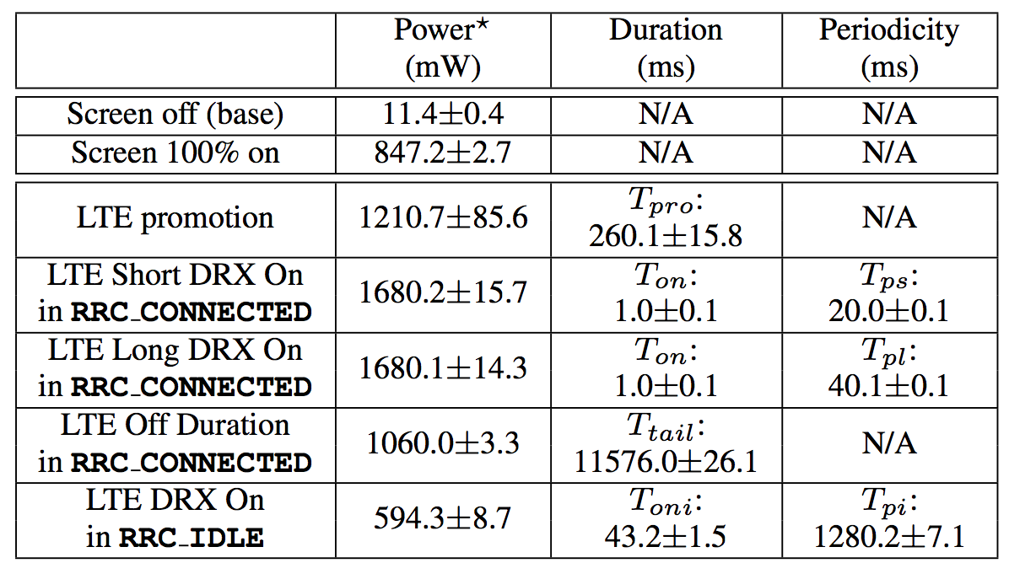
LTE power model (Verizon)
Measured with a LTE phone and Monsoon power meter, averaged with repeated samples
Notes:
We measure the power values and timer values for different RTT states.
We notice that in the RRC_CONNECTED tail, for any DRX cycle, the power level of the off duration is 1060mW.
And the tail timer is measured to be 11.6seconds

Slide 53
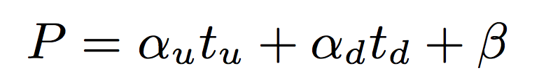
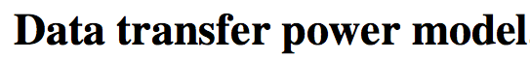
Power model for data transfer
A linear model is used to quantify instant power level:
Downlink throughput t_{d} Mbps
Uplink throughput t_{u} Mbps
Notes:
In addition to the power states, we also use a simple linear model to quantify the
instant power level based on the data rates in uplink and downlink.
The higher the throughput, the higher the power

Slide 54
Power model for data transfer
Verizon
A linear model is used to quantify instant power level:
Downlink throughput t_{d} Mbps
Uplink throughput t_{u} Mbps
AT&T
Notes:
We measure the linear model in both Verizon and AT&T networks and they share similar patterns.

Slide 55



Trace-driven modeling methodology
Real packet
traces collected
on smartphones
Adjusted packet timing and time series of RRC states
Network model
simulator
Calculated radio energy usage
Power model
simulator
Notes:
This slide summarizes the trace-driven modeling methodology used in our analysis.
The real packet traces are collected on smartphones and fed into the network model simulator,
Which outputs the adjusted packet timing based on RRC state machine and time series of RRC states.
This is further fed to the power model simulator which calculate the radio energy usage, with the help of the previously measured power models.

Slide 56

Power model validation
< 6% error rate in evaluations with real applications
Power meter
directly measure
Real applications
running
Packet traces +
Trace-driven analysis
Notes:
We validate our power model by comparing the total energy of real applications running measured directly by power meter and the calculated energy based on the trace-driven analysis.
The error rate is less than 6% for 5 real representative applications.

Slide 57
UMICH data set
20 voluntary smartphone users for seven months
Undergraduate and graduate students from 8 departments at University of Michigan
Data collected (152GB in total)
Full tcpdump packet traces
Process name for sending/receiving each packet
Screen status logger (1Hz)
Notes:
We use the UMICH data set, which is collected from 20 voluntary smartphone users for seven months.
These users are undergraduate and graduate students from 8 departments at university of michigan.
We collect full tcpdump packets, process name for sending/receiving each packet, phone screen status for every 1 second.

Slide 58
Comparing total energy of all user traces via simulation in LTE/3G/WiFi
Total energy usage
LTE/WiFi ≈ 23 3G/WiFi ≈ 15
Notes:
We first compare the total energy usage of all user traces by applying different power models to the traces.
In this figure, blue bars represent the energy ratio of LTE and WiFi
And red bars represent the energy ratio of 3G and WiFi.
In aggregate, we observe that LTE consumes up to 23 times the energy of WiFi, while 3G is 15 times of WiFi.
Across users, the ratio changes, but the overall pattern is consistent for all users.

Slide 59
Energy consumption break down
Tail energy dominates LTE energy consumption, similar to 3G
The total energy for different networks and users is normalized to be 100%
Notes:
We future break down the energy usage into 4 components with the help of the aforementioned network and power model simulator:
Promotion energy, data transfer energy, tail energy and idle energy.
We observe that tail energy takes up to 48% of the total energy for 3G and LTE network, while this problem does not exist in WiFi.

Slide 60
Energy consumption break down
Tail energy dominates LTE energy consumption, similar to 3G
The total energy for different networks and users is normalized to be 100%
The tail problem is the key factor for LTE’s high energy consumption, similar to 3G networks
Notes:
This indicates that the tail problem is the key factor for LTE high energy consumption, similar to 3G networks

Slide 61
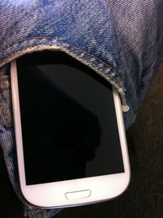
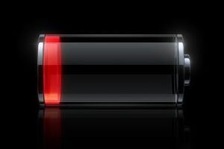
Screen-off traffic characterization
Smartphone screen is switched on and off often (>50 times/day/user)
Screen status is a good heuristic for determining whether the user is actively interacting with the device
Notes:
With the knowledge of the overall energy efficiency of different network types, we now look at the impact of traffic pattern on energy efficiency.
Specifically, we notice that in our data set, smartphone screen is switched on and off for > 50 times per day by each user in average.
Given that screen status is a good heuristic for determining whether the user is actively interacting with the device, thus affecting the traffic pattern, we look at the energy and ratio impact of screen-off traffic in the UMICH data set.

Slide 62
Breakdown of packet count based on screen status
Unknown group: 9% of all packets, due to users
accidentally terminating screen status logger
50%
%
Notes:
The breakdown of packet count based on screen status is shown as below.
We observe that 36% of all packets are screen-off packets.
There are 9% of packets with screen status unknown due to users accidentally killing our logger, so the actual screen-off percentage might be slightly higher.
We are interested to understand what is the energy and signaling impact of these screen-off packets.

Slide 63
Definition of a “burst”
A burst is a sequence of packets with inter-packet time ≤ BT, and leading/trailing gap > BT
BT is burst threshold selected empirically based on network RTTs, e.g. BT = 2s
≤ BT
≤ BT
> BT
…
> BT
Burst
Notes:
In order to understand the signaling impact, we first define one term in this study, whch is burst.
A burst is a sequence of packets with inter-packet time less than a burst threshold BT and the leading and trailing gap larger than BT.
The choice of burst threshold is based on the network RTTs and in our data set, we conservatively select BT as 2 seconds.
For the same number of packets, if there are more bursts, the traffic pattern is more scattered causing higher energy and signaling overhead.

Slide 64
Screen-on and screen-off traffic comparison
Screen-off traffic has less packets/payload, but more bursts, which are smaller and shorter
%
Notes:
We compare the the packet number, payload and burst number of screen-on and screen-off traffic in this figure.
In sum, screen-off traffic has smaller number of packets and less payload, but there are much more bursts in screen-off traffic, which are smaller and shorter.

Slide 65
Does screen-off traffic matter for radio resource and energy?
Yes! Actually, screen-off traffic has higher impact than screen-on, though with less packets
Notes:
We then compare the radio and energy impact between screen-on and screen-off traffic
We observe that the energy and signaling overhead for screen-off traffic is even higher than screen-on traffic.
Overall, about 60% of the radio energy is used during screen-off stage, which is about 20%~30% of the total energy of the device.
In the thesis, I talked about the proposed screen-aware optimization which can help reduce the energy and signaling impact of these screen-off traffic.
Due to the time limit, I will skip it.

Slide 66
Roadmap
MobiPerf: characterizing cellular network performance
Anatomizing smartphone application performance
An In-depth Study of LTE
Characterizing Radio Energy Usage
RadioProphet: Optimizing Smartphone Energy and Radio Resource
Notes:
With the understanding of the smartphone radio energy usage in cellular networks,
We will now discuss the RadioProphet system, which runs on Android and Optimizes Smartphone Energy and Radio Resource in Cellular Networks.

Slide 67
Radio Resource Control (RRC) State Machine
Transfer
the packet
Tail timer
expires
Tail timer
starts
A packet to
transfer
Power
Tail
Time
Promotion
Notes:
To understand the energy and signaling impact of network traffic, we review the Radio resource control state machines in cellular networks, or RRC state machines.

Slide 68
Fast Dormancy (FD)
Fast dormancy reduces the tail length by actively notifying the network for early demotion
Fast dormancy
tail timer
Default tail timer
Fast dormancy
Power
Time
68
Notes:
There is an existing standard for cellular networks called fast dormancy which reduces the tail length by actively notifying the network for early demotion.
However, when to invoke fast dormancy is an open research question.

Slide 69
Problem with the Naïve Fast Dormancy
Extra promotion overhead
UE energy and delay overhead
Signaling overhead
32 radio messages exchanged between UE and cell tower for promotion
No FD
Power
FD
Time
Notes:
For the naïve fast dormancy, which always invoke fast dormancy after a short time, there may be some problem.
As illustrated by this figure, although the tail energy is reduced, the promotion energy is increased.
And besides energy, signaling overhead due to the excessive promotions is also of concerns.
For example, about 32 radio messages need to be exchanged between UE and cell tower for promotion and if too many devices trigger promotion simultaneously, the cellular network may become overloaded.

Slide 70
RadioProphet: Intelligently Invoke FD
RadioProphet
No FD
Power
FD
Time
Notes:
The RadioProphet system is designed to make intelligent invocation of fast dormancy which saves tail energy, while in the meanwhile without incurring excessive signaling overhead.

Slide 71
RadioProphet: Intelligent Radio Resource Deallocation for Cellular Networks
Notes:
This figure summarizes the architecture and working flow of RadioProphet.
The data collector collects traffic information and feed them to the inter-burst-time or IBT prediction framework,
Which then predicts the IBT following the current burst.
Based on the prediction results, the fast dormancy scheduler will make decisions whether to invoke FD or not.
If the IBT is long, we should trigger fast dormancy to save power. Otherwise, we should just stay in the tail to avoid extra promotions and excessive signaling overhead.

Slide 72
Inter-Burst Time (IBT) Prediction
Traffic features
Packet direction, port, packet length, protocol, TCP flags, application ID
Machine learning algorithms
Naïve Bayes
Regression tree
Classification tree
Ensemble boost
etc.
Notes:
For IBT prediction, we select traffic features including packet direction, port, packet length, protocol, TCP flags and application IDs, while ignoring other features as they are tested to be less relevant to IBT.
We have different off-the-shelf machine learning algorithms as candidates including naïve bayes, classification tree, etc.

Slide 73
Example Feature Selection – TCP Flags
Notes:
This figure shows the effect of one single feature, TCP flags.
For example, the SYN and PSH/ACK packets have high correlation with short IBT and
machine learning algorithms are able to figure out such correlation and other other correlations in the other features automatically.

Slide 74
Implementation and Evaluation
Data collector
Modified tcpdump cross-compiled for Android
Collect traffic for prediction
< 2% CPU overhead (energy overhead < 1% tail energy)
IBT prediction framework
Weka machine learning library ported to Android
Average model training time 200ms, prediction time 0.1ms (energy overhead < 1% tail energy)
Best accuracy for all users in the UMICH data set is 86%
Overall performance
Energy saving: 59% of radio energy (20% ~ 30% total energy)
Signaling overhead reduction: 57% comparing with default FD
Notes:
We implement the whole RadioProphet system on Android.
For data collector, we modified the tcpdump and cross-compiled it for Android.
It collects traffic information and incurs < 2% CPU overhead with energy overhead < 1% of the RRC tail energy.
We make some changes to the existing Weka machine learning library and are able to run it on real Android device.
The average model training time is 200ms and the prediction time is negligible.
The energy overhead for is also < 1% of the tail energy.
The prediction accuracy can reach 86% for all users in the UMICH data set.
Overall, RadioProphet saves 59% of radio energy, which is 20% to 30% the total UE energy.
It also helps reduces the signaling overhead by 57% compared with the default fast dormancy approach.
This demonstrates the effectiveness and practicability of the RadioProphet system.
============================
Fast Dormancy scheduler
No known interface for invoking FD on Android
FD is available and send dummy packet to invoke “no-FD”
In terms of fast dormancy scheduler, FD is available on our test device.
Given that there is no known interface for invoking FD on Android due to the lack of OS support, we use a trick which sends dummy packet to invoke “no-fast dormancy”.

Slide 75
Summary and future agenda
Optimizing cellular network and power resource usage for mobile applications is important and requires further study
MobiPerf
A more general mobile measurement platform to better benefit the research community in both the tool and the data
Longitudinal study of the evolution of cellular networks
RadioProphet
To consider more TCP- and application-layer context to improve prediction accuracy
Public deployment and OS integration
Notes:
To summarize, further study is still required for optimizing cellular and power resource usage for mobile applications.
The future work for MobiPerf includes making it a more general mobile measurement platform to better serve the research community and
making a longitudinal study of the evolution of cellular networks with data set collected over the years.
For RadioProphet, we can consider more TCP- and application-layer context to make the prediction more intelligent and accurate.
It is also important to study how to deploy RadioProphet publicly and how to integrate it with Android OS better.

Slide 76

Thank you!
Notes:
Thank you and I’m glad to take questions!

Slide 78

Carpe Diem

Slide 79
Backup slides

Slide 80
Impact of concurrent TCP connections
An improvement of 30% is observed when concurrency limit on the phone is removed
Default limit
Notes:
We first study the impact of concurrent TCP connections on web browsing performance.
We vary the maximum allowed concurrency on the client and observe a decrease of page loading time as the concurrency grows.
The default limit on maximum concurrency is 4 on existing smartphone platforms an we observe a 30% speedup once such limit is removed.

Slide 81
Compression improves performance
Tradeoff between client decompression processing and network data size reduction
Network is more dominant
Performance improvement is significant
30% speedup for iPhone when RTT is 800ms
Notes:
Then we look at the impact of compression on web performance.
Intuitively, there is a tradeoff between client decompression processing and network data size reduction.
And we observe that the network factor is more dominant for 3G networks.
In the figure, we show the page loading time of 3 smartphones in compression v.s. no compression model.
X axis is the RTT we controlled so as to understand the impact of compression understand different network conditions.
The performance improvement is more significant when the network condition is worse, for example,
When RTT is 800ms, compression helps iPhone speedup by 30%

Slide 82
Highlight observations
TCP flow size exhibiting strong heavy-tail distributions, similar to wired networks
90% flows < 3 KB uplink, < 36 KB downlink payload
Top 0.6% of flows have 62% total downlink bytes
TCP concurrency is not high
1 TCP flow actively downloading for 72% of the time
In 2G/3G networks, usually the RAN latency dominates the overall end-to-end delay; no longer the case in LTE networks
Notes:
Using this data set, we first study the network and traffic characteristics in LTE networks and compare with other network types.
We observe that similar to wired networks, TCP flow size exhibits strong heavy-tail distribution, with 90% flows having very small payload in both uplink and downlink.
Also the top 0.6% of flows account for 62% of total downlink bytes.
We also observe that the TCP concurrency for the existing mobile applications running in the LTE networks is not high, and for 72% of the time, there is only 1 TCP flow actively downloading data.
Previously, in 2G/3G networks, we observe that the RAN latency dominates the overall end-to-end delay and this is no longer the case in LTE networks,
as we observe comparable delay in the cellular network as in the Internet paths.

Slide 83
Breakdown of content type for all HTTP traffic based on content size
Video and image contents are dominant
Notes:
We further break down the content type for all HTTP traffic based on content size.
We observe that video and image contents are dominant in the LTE traffic, and these web objects are typically larger in size than text contents.

Slide 84
3GTest: Global 3G network performance measurement
Measure 3G network performance from users’ devices
Cross-platform
iPhone OS, Android (Birjodh Tiwana) and Windows Mobile (Qiang Xu)
Global deployment
60,000+ users, 140,000+ runs from 08/2009 to 04/2010
Notes:
3GTest is used for measuring the previous metrics globally
Talk about which is my part (iPhone + server design and implementation) and which are collaborator’s parts

Slide 85
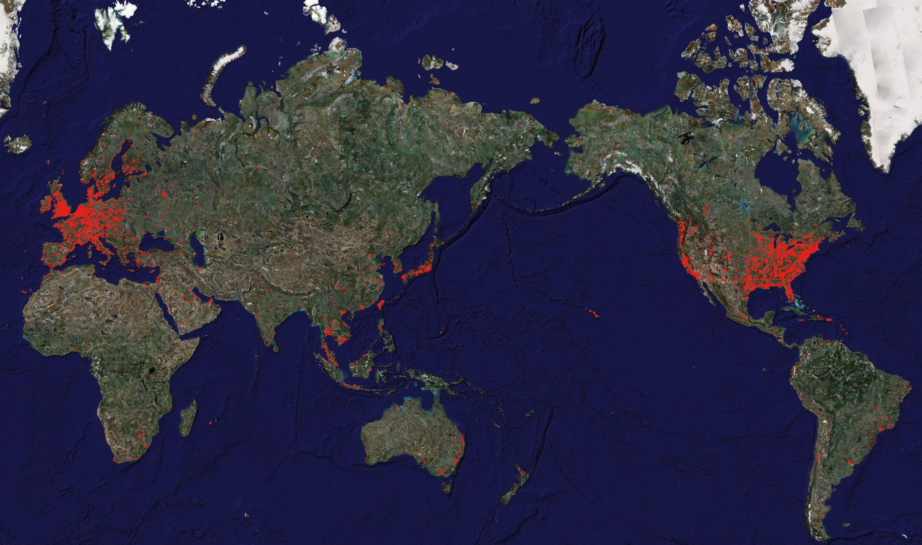
3GTest collects representative results in many countries

Slide 86
Insights of 3G Network Performance
3G downlink bandwidth is low
< 1Mbps
Common 3G network condition
RTT 400ms and loss rate 0%
Carrier network delay dominates end-to-end RTT
End-end ping close to ping to 1st hop
Local DNS server performance is good
200 ms comparable to ping to 1st hop
High variation
Across carriers, and among the same carrier
Within one TCP connection
Notes:
We first summarize the main observations on 3G network performance from Mobiperf data set.
1. 3G downlink bandwidth is low and most of them is < 1Mbps
2. We have compared the performance of different carriers and found that RTT 400ms and loss rate 0% is a representative network scenario for 3G networks.
3 By comparing Ping to the 1st IP hop and ping to end servers, we conclude that carrier network delay dominates end-to-end RTT
4. Given that local DNS lookup time is very close to the ping to the first hop, LDNS server performance is considered to be good
5. In addition, we also observe high variation for different metrics across carriers, among the same carrier, and even within the same TCP connection.

Slide 87
Insights of LTE, WiFi, WiMAX Network Performance
Downlink throughput
LTE median is 13Mbps, up to 30Mbps
WiFi, WiMAX < 5Mbps median
Uplink throughput
LTE median is 5.6Mbps, up to 20Mbps
WiFi, WiMAX < 2Mbps median
RTT
LTE median 70ms
WiFi similar to LTE
WiMAX 150ms

Slide 88
LTE Network characteristics
4GTest on Android
Measures network performance with the help of 46 M-Lab nodes across the world
3,300 users and 14,000 runs in 2 months 10/15/2011 ~ 12/15/2011
4GTest user coverage in the U.S.
Notes:
To make such large-scale measurement, we developed and published an app called 4GTest in Android market.
In order to make sure that the Internet path does not become the bottleneck, 4GTest chooses the closest M-Lab nodes to connect to, which are distributed across the world.
Within 2 months of deployment, we collect data from more than 3000 users
Based on this figure, we can see that our data set has a reasonably good coverage in the United States.

Slide 89
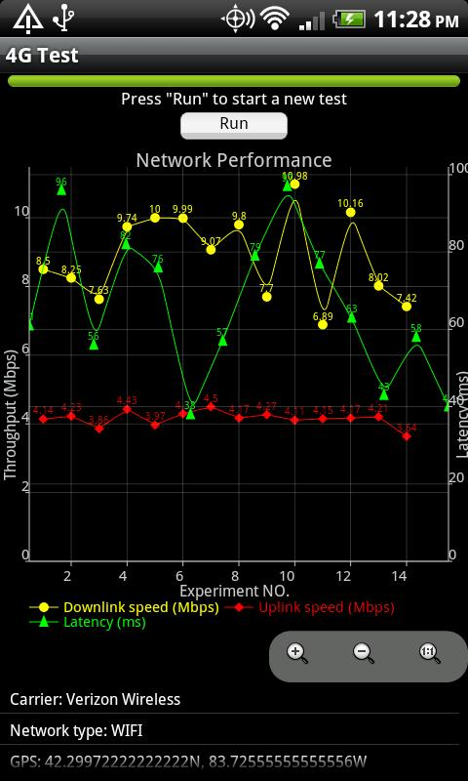
LTE Network characteristics
4GTest on Android
Measures network performance with the help of 46 M-Lab nodes across the world
3,300 users and 14,000 runs in 2 months 10/15/2011 ~ 12/15/2011
4GTest user coverage in the U.S.
Notes:
To make such large-scale measurement, we developed and published an app called 4GTest in Android market.
In order to make sure that the Internet path does not become the bottleneck, 4GTest chooses the closest M-Lab nodes to connect to, which are distributed across the world.
Within 2 months of deployment, we collect data from more than 3000 users
Based on this figure, we can see that our data set has a reasonably good coverage in the United States.

Slide 90
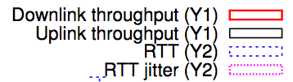
Downlink throughput
LTE median is 13Mbps, up to 30Mbps
The LTE network is relatively unloaded
WiFi, WiMAX < 5Mbps median
Notes:
We compare the downlink throughput of LTE with WiFi and WiMax.
LTE’s median throughout is 13Mbps, and for some users, it can be up to 30Mbps.
We need to notice that LTE network is currently relatively unloaded due to its new coming.
For WiFi and WiMAX, their median downlink throughput is smaller than 5Mbps. And 3G networks are lower.

Slide 91
Uplink throughput
LTE median is 5.6Mbps, up to 20Mbps
WiFi, WiMAX < 2Mbps median
Notes:
For uplink throughput, LTE’s median throughput is 5.6Mbps, which is also much higher than that of WiFi or WiMAX.

Slide 92
RTT
LTE median 70ms
WiFi similar to LTE
WiMAX higher
Notes:
For RTT, LTE and WiFi have similar median value of 70ms,
WiMAX and 3G networks have higher RTTs, and the median value is between 100ms and 200ms.
In sum, LTE has significantly improved throughput and RTT performance over 3G and WiMAX
and it now has even better performance than WiFi.

Slide 93
Tradeoffs of Ttail settings
Ttail setting | Energy Consumption | # of state transitions | Responsiveness
Long | High | Small | Fast
Short | Low | Large | Slow
Notes:
Ttail is a very important parameter for both 3G and 4G networks.
It incurs tradeoffs between UE energy consumption, signaling overhead in the network quantified by the # of state transitions here
, and responsiveness
When Ttail is set to be a long value, UE consumes more energy, with smaller # of state transitions and fast responsiveness since UE spends more time in the RRC_CONNECTED state and there is less promotion delays.
When Ttail is set to be a short value, UE consumes less energy, incurring larger number of state transitions and more promotions delays
Later in this talk, we will explore in more details the impact of setting Ttail for LTE network.

Slide 94









Smartphones are popular
Various smartphone platforms
Many applications
High speed network access
3G (UMTS & EVDO)
4G (LTE)

Slide 95
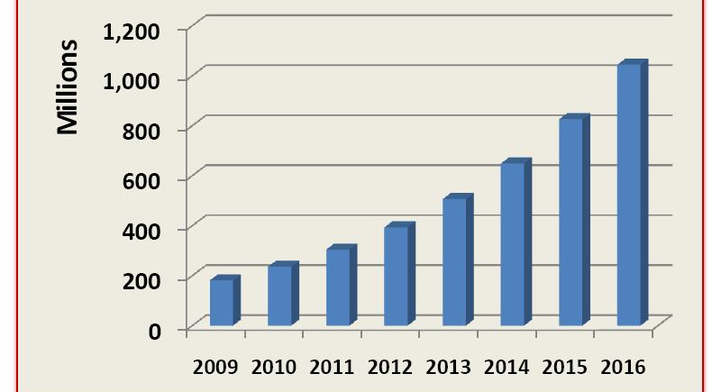
Smartphone shipments prediction on 2009
Predicted on 2009: 2012 Global smartphone shipments 385 million

Slide 96
Smartphone shipments booming
2012 Global smartphone shipments: 717 million
How about 2016?

Slide 97
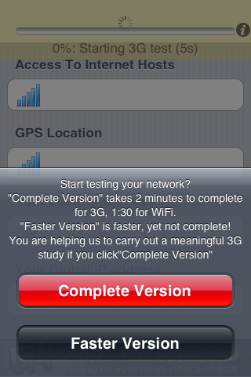
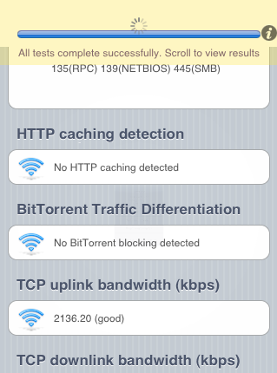
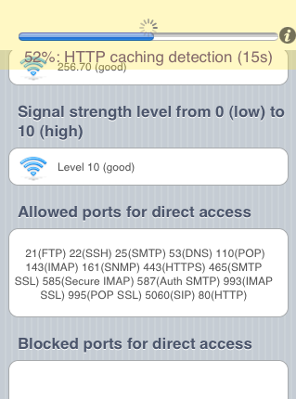
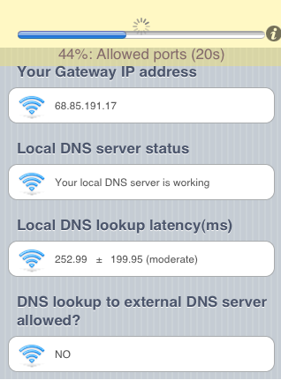
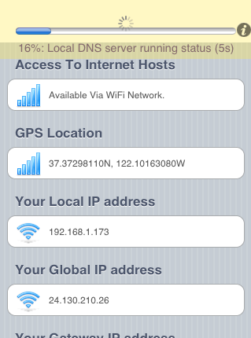
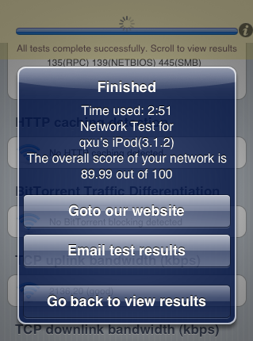
Design of 3GTest
Avoid personal identifiable information
http://mobiperf.com
Notes:
Avoid personal identifiable information
Limit running time
Simple UI with one click to run
Leave users the option to run once or multiple times

Slide 98
Key challenges of 3GTest design – public tool to measure 3G network performance
Adoptability
User privacy
Running time
Ease of use
Energy consumption
Data usefulness
Metrics relevant to network applications
Notes:
Talk about the challenges and our solutions
To extract important network metrics and understand network properties
To measure the network metrics globally to analyze commonalities and compare differences.

Slide 99
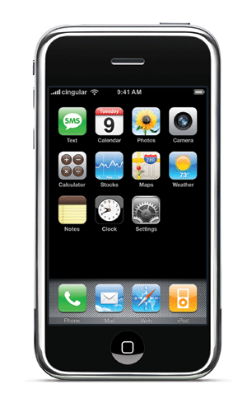
What information is most relevant for 3GTest?
example.com?
Get index.html
192.0.32.10
<html></html>
Local DNS server
Smartphone
Web server
Ping to 1st hop
End-end ping
Notes:
DNS performance
Local DNS lookup time
TCP performance
Throughput
RTT
Loss rate
Ping performance
Latency to landmark servers
Latency to the first hop

Slide 100
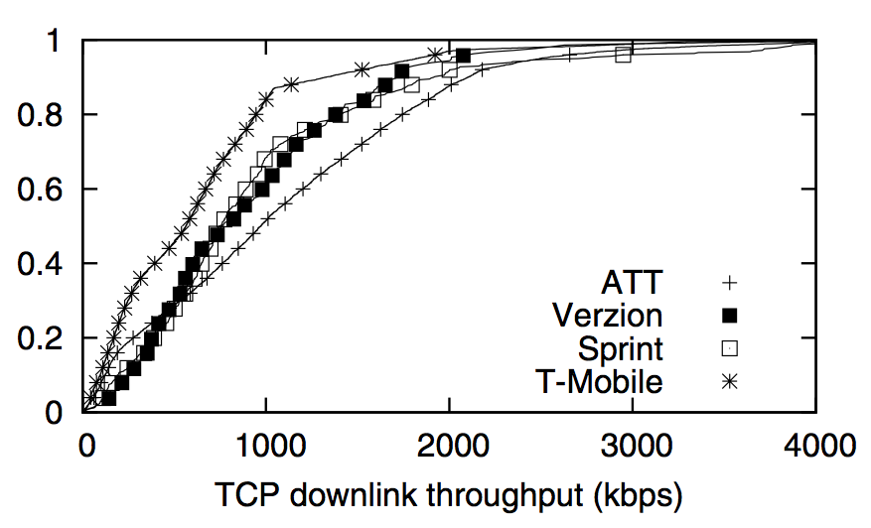
Throughput comparison
T-Mobile:600kbps
CDF
AT&T
1Mbps
Notes:
1, variation within each carrier
2, common throughput values
3, ATT > T-Mobile

Slide 101
RTT comparison
T-Mobile
450ms
CDF
AT&T
350ms
Notes:
1, variation within each carrier
2, common RTT values 400ms (higher than Internet values)
3, ATT > T-Mobile (T-Mobile has high RTT)

Slide 102
TCP RTT comparison across carriers
RTT of each carrier has high variation
400ms can be selected as a common RTT in 3G networks
Notes:
RTT common value for 3G networks

Slide 103
Retransmission rate comparison
AT&T
CDF
T-Mobile
Notes:
1, common retransmission values
2, UMTS vs. EVDO (possibly due to link-layer retransmission
Link-layer retransmission for low loss rate

Slide 104
TCP retransmission rate comparison across carriers
TCP retransmission rate is low (0% selected)
T-Mobile and AT&T’s median of TCP retransmission rate is 0%, while Sprint and Verizon have 0.7%
Notes:
Loss rate

Slide 105
Ping to the first hop

Slide 106
Ping to end server

Slide 107
Time of day effect on network performance

Slide 108
Simple website page load time break down
TCP transfer time
TCP idle time
http://m.ebay.com
Notes:
Compare left to right: performance gap among devices become more obvious for content-rich websites because TCP transfer time and idle time become more of a bottlenecks
Web bottlenecks: idle time and transfer time ( client exe + data download) not TCP handshake, DNS

Slide 109
Content-rich website page load time break down
TCP transfer time
TCP idle time
http://mapquest.com
Notes:
Compare left to right: performance gap among devices become more obvious for content-rich websites because TCP transfer time and idle time become more of a bottlenecks
Web bottlenecks: idle time and transfer time ( client exe + data download) not TCP handshake, DNS

Slide 110
Observations of web browsing performance study
Web browsing performance factors
Bottlenecks
Client execution & network download
Non-bottlenecks
DNS lookup & TCP handshake time
Appropriately increasing concurrency improves performance
30% improvement when the default limit on smartphone browser is removed
Compression helps improve performance
30% speedup for iPhone when RTT is 800ms
Content customization is important
Increase performance by 20%
Notes:
Major observations

Slide 111
Data URL scheme improves performance
Increase loading speed by 20%
Limited support
No support on Windows Mobile phones
Notes:
Data URL scheme helps improves performance but not well-supported by all platforms

Slide 112
JavaScript execution comparison
JavaScript execution is 20-80X slower on smartphones than on desktops
Large JavaScript execution time leads to more TCP idle time and under-utilized network
80X (CPU <10X)
PC
Notes:
1 Background: choose to use JavaScript because it is the most common scripts which require client processing
2 PC vs. smartphone difference is big (js is expensive on smartphones, content providers need to optimize contents)
3 Difference among different smartphones are big
4 Possible reasons include CPU speed difference and JS engine software performance difference

Slide 113
JavaScript execution comparison (2012)
From 2009 to 2012, smartphones have significantly improved JavaScript execution speed
Notes:
We first revisited the smartphone processing capability analysis that we carried out in 2009.
To understand the smartphone’s processing capability, we use JavaScript execution speed as a representative metric.
The JavaScript benchmark suite we used is the same in 2009 and 2011.
In 2009, we found that the execution speed for smartphone browsers could be up to 20∼80 times slower than desktop browsers.
From 2009 to 201, there is a 20 – 50 times speed up for smartphone browsers.
And the gap between smartphones and computers has dropped to 5 ∼ 20 times in 2011.

Slide 114
App case study in LTE networks
Studied 5 web-based apps
LTE has comparable page loading time as WiFi, with 3G lagging behind
CPU usage for LTE/WiFi is between 80% ~ 90% during page loading
Network does not appear to be the bottleneck
Notes:
We studied 5 web-based application in our test device and
here lists the most important lessons we learnt.
First, LTE has comparable loading time with WiFi for these applications, and 3G’s loading time is longer, as expected.
Second, we monitor the CPU usage, during the loading of these applications, in LTE and WiFi networks, the average CPU usage is between 80% to 90%.
This indicates that the network is less of a performance bottleneck, and the UE processing is the bottleneck, even though smartphone processing speed has significantly improved.
For 3G, the CPU usage is about 35% to 70%, indicating that network is more of a bottleneck.
In terms of the total energy consumed in loading these applications, LTE consumers more energy than 3G, and the two are much more energy consuming than WiFi.

Slide 115
Implications for improving web browsing performance
Client execution
Improve JavaScript execution speed on smartphones
CPU speed improvement
Browser software optimization
Network transfer
Appropriately increase parallel TCP connections
Server configuration & content customization
Compress contents before transfer
Add data URL scheme support
Notes:
Summarize how to improve web browsing performance on smartphones ( answers question 3 in the problem statement)

Slide 116
App case study in LTE networks
In LTE networks, applications should more aggressively burst traffic to make more efficient use of the bandwidth given the high energy overhead
Studied 5 web-based apps
LTE has comparable page loading time as WiFi, with 3G lagging behind
CPU usage for LTE/WiFi is between 80% ~ 90% during page loading
Network does not appear to be the bottleneck
Notes:
All these lesson implies that, when designing smartphone applications that include network activities,
The guideline is that, for LTE network, since it provides a very high network throughput at the cost of high energy usage,
Applications should more aggressively burst traffic and reduce periodic small data transfers whenever possible.
This helps make better use of the available bandwidth and saves UE energy

Slide 117
Interesting questions about LTE
To users: what is the end performance?
Network performance, such as RTT and throughput, how it compares with WiFi, 3G and WiMAX, etc.
Energy efficiency affecting battery life, is LTE more power efficient than 3G or WiFi?
To ISPs: what is the impact of configuring LTE-related parameters on UE power saving, and delay/signaling overhead?
To OS/application developers: what is the performance bottleneck of applications in LTE network, CPU or network speed?
Notes:
Given the previous discussion on LTE networks, in this study,
We raise some interesting questions about LTE network that are of interest of users, mobile ISPs and OS/application developers.
For users, they are interested to understand the network performance of LTE network and how it compares to other technologies, such as 3G, WiFi, WiMAX, etc.
For ISPs, the impact of configuring LTE-related parameters on energy saving and delay and signaling overhead is yet to be studied.
For OS and application developers, we want to study how the new LTE network would affect the application design
And what the is the performance bottleneck of mobile applications is it CPU or network speed.
(Merge with the first transition slide)

Slide 118
RRC state transitions in LTE
DRX: Discontinuous Reception
Listens to downlink channel periodically for a short duration and sleeps for the rest time to save energy at the cost of responsiveness
Notes:
Discontinuous reception, or DRX, is an important feature in LTE for energy saving purpose.
Instead of continuous monitoring downlink channel, in DRX, UE only listens to downlink channel periodically for a short duration, and sleeps for the rest time to save energy at the cost of responsiveness.

Slide 119
Discontinuous Reception (DRX): micro-sleeps for energy saving
In LTE 4G, DRX makes UE micro-sleep periodically in the RRC_CONNECTED state
Short DRX
Long DRX
DRX incurs tradeoffs between energy usage and latency
Short DRX – sleep less and respond faster
Long DRX – sleep more and respond slower
In contrast, in UMTS 3G, UE is always listening to the downlink control channel in the data transmission states
Notes:
We explain DRX in more details here.
In LTE 4G networks, DRX makes UE micro-sleep periodically in RRC_CONNECTED state.
There are two types of DRX in RRC_CONNECTED, Short DRX and Long DRX.
Different types of DRX incurs tradeoffs between battery saving and latency.
Short DRX sleeps slightly less with smaller energy saving and respond faster
Long DRX, sleeps more with more energy saving and respond slower.
The DRX in the data transmission state is one major difference between 3G and LTE.
In UMTS 3G networks, during the data transmission states, UE is continuously listening to the downlink control channel

Slide 120
DRX in LTE
A DRX cycle consists of
‘On Duration’ - UE monitors the downlink control channel (PDCCH)
‘Off Duration’ - skip reception of downlink channel
T_{i}: Continuous reception inactivity timer
When to start Short DRX
T_{is}: Short DRX inactivity timer
When to start Long DRX
Notes:
Now let’s look at DRX with a microscope.
DRX is periodic and each DRX cycle consists of
‘On Duration’ during which UE monitors the downlink control channel
‘Off Duration’ during which UE can sleep and skip the reception of downlink channel for battery saving purpose.
The On Duration is typically much smaller than the Off Duration so as to make effective energy saving
First, let’s start from the red dots where the UE starts transferring data.
Every time a packet is sent or received, the continuous reception inactivity timer Ti is started.
And when Ti expires, UE starts short DRX.
Then the short DRX inactivity timer Tis starts and when Tis expires without seeing any data, long DRX starts.

Slide 121
RRC state transitions in LTE
Send/receive
a packet
Continuous Reception
Reset Ti
Notes:
Add T_pro, have another slide showing all numbers
Each time data is sent/received Ti and Ttail are reset, Tis is when Short DRX starts, Ti + Tis << Ttail, animation to show how Timers are set (only appear after started)

Slide 122
RRC state transitions in LTE
Ti expires
Short DRX
Ti stops, Tis starts
Notes:
Add T_pro, have another slide showing all numbers
Each time data is sent/received Ti and Ttail are reset, Tis is when Short DRX starts, Ti + Tis << Ttail, animation to show how Timers are set (only appear after started)

Slide 123
RRC state transitions in LTE
Continuous Reception
Send/receive
a packet
Reset Ti, stops Tis
Notes:
Add T_pro, have another slide showing all numbers
Each time data is sent/received Ti and Ttail are reset, Tis is when Short DRX starts, Ti + Tis << Ttail, animation to show how Timers are set (only appear after started)

Slide 124
RRC state transitions in LTE
Tis expires
Long DRX
Tis stops
Notes:
Add T_pro, have another slide showing all numbers
Each time data is sent/received Ti and Ttail are reset, Tis is when Short DRX starts, Ti + Tis << Ttail, animation to show how Timers are set (only appear after started)

Slide 125
RRC state transitions in LTE
Continuous Reception
Send/receive
a packet
Reset Ti
Notes:
Add T_pro, have another slide showing all numbers
Each time data is sent/received Ti and Ttail are reset, Tis is when Short DRX starts, Ti + Tis << Ttail, animation to show how Timers are set (only appear after started)

Slide 126
Power trace of DRX in RRC_CONNECTED
Notes:
This figure is a zoom-in view of the power traces in RRC_CONNECTED model.
We can observe an obvious periodic behavior of DRX and around every 40ms
UE wakes up to check the downlink control channel for a very short period and goes back to sleep again.
To point to the difference

Slide 127
One way delay and impact of packet size
LTE uplink one way delay (OWD) is larger than that of downlink
RTT in LTE is more sensitive to packet size than WiFi, mainly due to uplink OWD

Slide 128
LTE power model Verizon
Measured with a LTE phone and Monsoon power meter, averaged with repeated samples
Notes:
We measure the LTE power model with our test device and Monsoon power meter.
And we take the average with repeated samples.
All the energy are measured with screen turned off.

Slide 129
LTE power model Verizon
Measured with a LTE phone and Monsoon power meter, averaged with repeated samples
Notes:
As a reference for comparison, we measure the power level when the device is doing nothing but with the screen 100% on.
The power level is around 850 mW.

Slide 130
LTE power model Verizon
Measured with a LTE phone and Monsoon power meter, averaged with repeated samples
Notes:
For DRX on duration, the power level is even higher, up to 1680mW.

Slide 131
LTE power model Verizon
Measured with a LTE phone and Monsoon power meter, averaged with repeated samples
P(on) – P(off) = 620mW, DRX saves 36% energy in RRC_CONNECTED
High power levels in both On and Off durations in the DRX cycle of RRC_CONNECTED
Notes:
We make two interesting observations out of this table.
First, we notice that the DRX on duration has a higher power level than that of the off duration and
The gap between on and off is 620mW. This large gap allows the DRX to save 36% energy in RRC_CONNECTED state.
So DRX is effective.
Second, both on and off durations in the DRX cycle of RRC_CONNECTED, have high power levels.
So even though DRX helps save significant amount of energy, LTE still has high energy consumption in RRC_CONNECTED state.
This observation suggests that the high-power tail might still be a key source of energy inefficiency of LTE network as it is in 3G network.

Slide 132
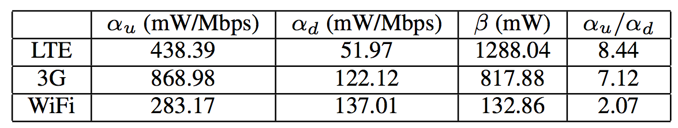
Power model for data transfer
A linear model is used to quantify instant power level:
Uplink/downlink throughput t_{u}/t_{d} (Mbps)
< 6% error rate for predicting energy usage of 5 real applications

Slide 133
Trace-driven modeling methodology
Network model simulator
Take binary packet trace files in libpcap format as input
Remove existing state transition delays
Apply a specific network model and adjust timestamps for some packets
Output time series of packet arrival and RRC states
Power model simulator
Takes the output of network model simulator as input
Apply the corresponding power model and calculate radio energy usage

Slide 134
LTE consumes more instant power than 3G/WiFi in the high-power tail
Average power for WiFi tail
120 mW
Average power for 3G tail
800 mW
Average power for LTE tail
1080 mW
Notes:
We compare the instant tail power level of the three network types, since tail energy is the main source of wasted energy.
WiFi appears to be the least power consuming, only 120 mW.
3G tail has a high power level of 800 mW.
LTE has the even higher power level in RRC_CONNECTED mode, 1080 mW.
Considering that LTE tail timer is even longer than that for 3G in our measured network, more energy is wasted in the tail for LTE than 3G in that network.

Slide 135
Energy per bit comparison
LTE’s high throughput compensates for the promotion energy and tail energy
Transfer Size | LTE μ J / bit | WiFi μ J / bit | 3G μ J / bit
10KB | 170 | 6 | 100
10MB | 0.3 | 0.1 | 4
Total energy per bit for downlink bulk data transfer
Notes:
In this table, we compare the energy per bit for the three networks in the downloading bulk data with different sizes.
For a small download of 10KB, LTE and 3G is clearly much more power consuming than WiFi, with LTE as 170 μJ/bit
However, when we download a large file of 10MB LTE’s high throughput compensates for the promotion energy and tail energy.
The energy per bit for LTE in this scenario is 0.3 μJ/bit, which is comparable to WiFi’s μJ/bit. While for 3G, it is much worse, with 4 μJ/bit.

Slide 136
Energy per bit comparison
LTE’s high throughput compensates for the promotion energy and tail energy
Small data transfer, LTE wastes energy
Large data transfer, LTE is energy efficient
Transfer Size | LTE μ J / bit | WiFi μ J / bit | 3G μ J / bit
10KB | 170 | 6 | 100
10MB | 0.3 | 0.1 | 4
Total energy per bit for downlink bulk data transfer
Notes:
So the high level observation for LTE network is that
It wastes energy for small data transfers,
But could become energy efficient for large data transfer.
For large data transfers, LTE has comparable energy efficiency compared with WiFi.

Slide 137
Energy per bit comparison
For large data transfer with maximum rate, LTE’s energy efficiency is comparable with WiFi, due to LTE’s high downlink throughput
Notes:
Add comparison between WiFi and LTE’s absolute power levels.
The result in this slide is not general, because WiFi has < 6Mbps.
Probably remove this figure.
Add back this slides, remove the figure, put numbers.
Useful for bundle the data transfer

Slide 138
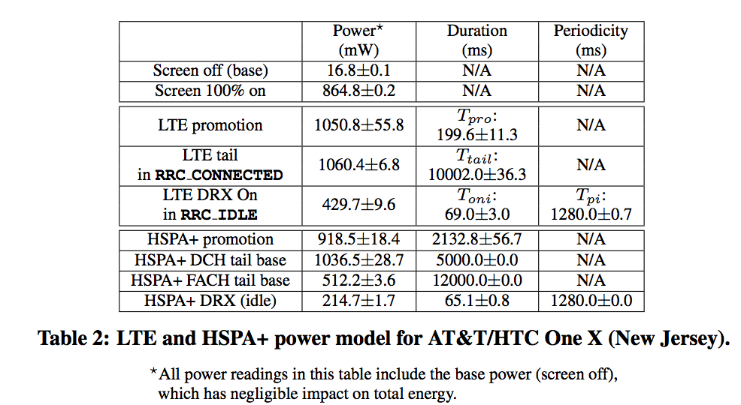
LTE power model AT&T (New Jersey)

Slide 139
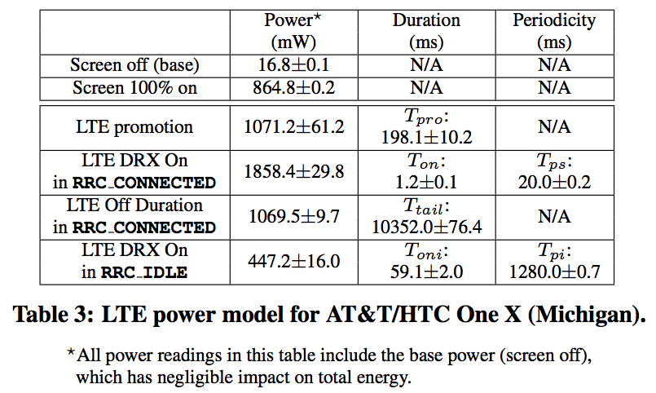
LTE power model AT&T (Michigan)

Slide 140
User trace based analysis
UMICH data set
Collected from 20 volunteer smartphone users for five months, totaling 118GB
Contains packet traces including full payload
Trace-driven modeling methodology
Network model simulator
Simulates network states, such as RRC state transitions
Power model simulator
Calculates power usage based on the network states
Notes:
The approach we took for such comparison is the user trace based simulation analysis.
The data set we have is collected from 20 volunteer smartphone users for 5 months.
It contains packet traces with full payload.
We feed these traces into our network model simulator which simulates RRC state transitions
and power model simulator which is used to calculate energy usage based on the different network states.
This approach is not perfect since it is inherently challenging to replay user behaviors in different networks, especially when remote entities have been involved.
However, we believe that this approach provides a representative comparison for the energy efficiency of different networks.

Slide 141
Comparing total energy of all user traces via simulation in LTE/3G/WiFi
Total energy usage
LTE/WiFi ≈ 23 3G/WiFi ≈ 15
Notes:
We first compare the total energy usage of all user traces.
In this figure, blue bars represent the energy ratio of LTE and WiFi
And red bars represent the energy ratio of 3G and WiFi.
In aggregate, we observe that LTE consumes up to 23 times the energy of WiFi, while 3G is 15 times of WiFi.
Across users, the ratio changes, but the overall pattern is consistent for all users.

Slide 142
Design tradeoff in smartphone measurement
User coverage vs. collected information
Liu, MobiCom 2008
Zhong, HotMetrics 2010
More info
Fewer users
Our study
Speedtest.net
FCC’s broadband test
Collected information
Less info
More users
User coverage
Willkomm, DySPAN 2008
Notes:
Discuss tradeoff: jailbroken / user privacy

Slide 143
Key challenges of web performance analysis
Multiple factors have impact
Network condition
Client settings
Server configurations
Content differences
Lack of low-level information and access
No visibility into link layer
Difficult to instrument client OS and application
No access to public web servers
Notes:
1 because various factors have joint impact

Slide 144
How to isolate impact of individual factor?
Vary one factor at a time
Network condition
Simulate cellular network with WiFi
Client settings
Control TCP concurrency
Server configurations
Change compression mode and server parallelism
Content difference
Host static website snapshots locally
Notes:
Present our solutions
each of which solves one problem in the problem statement
assume WiFi's performance is predictable due to a lack of contention.
WiFi has higher performance so you can create bottlenecks to emulate 3G.

Slide 145
How to identify performance bottlenecks?
TCP flow analysis technique to break down page load time
DNS lookup time
TCP handshake time
TCP idle time
TCP transfer time
index.html
logo.png
Time
Notes:
DNS lookup time – local DNS server lookup time
TCP handshake time - RTT
TCP idling time - client execution time
TCP transfer time - network performance & server delay

Slide 146
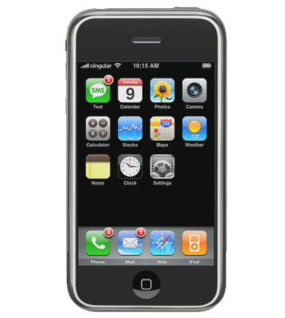
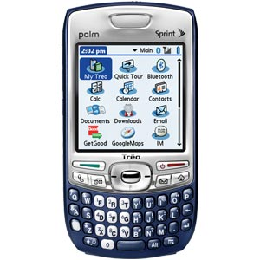
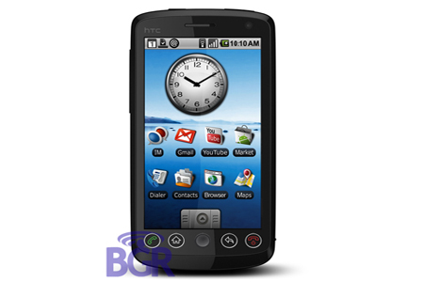







Controlled experiment setup
Platform
Web browsing
Notes:
Talk about the carrier and devices used for controlled experiments
20 URLs include mail, search engines, social networks, maps.

Slide 147
Data set studied
Collected from 20 volunteers in 5 months
May 2011 ~ Oct 2011, Android 2.2 smartphones
Full packet payload and process association is collected
131.49 millions packets
80.03GB payload
Screen on/off status with sampling rate of 1Hz
Notes:
To study the screen-off traffic, we use a data set …
…
When we first got the data set, we are curious how many packets are generated during the screen-off stage

Slide 148
How does traffic pattern affect energy and radio resource?
Scattered traffic consumes more energy and radio resource than Gathered traffic
Scattered
traffic
Power
Gathered
traffic
Time
Notes:
Radio resource control state machine is important in determining cellular radio resource usage and UE energy consumption.
We need to understand two terms used in this study.
Promotion is …
Tail is defined to be the period that UE continus to stay in the high-power state

Slide 149
Top screen-off applications based on packet count
Application category | screen-off packets / total packets
Homescreen widget | 3.80%
Multimedia streaming | 3.30%
Utility | 2.69%
Multimedia streaming | 2.66%
Multimedia streaming | 2.37%
Utility | 2.07%
Social network | 1.95%
News | 1.94%
Email | 1.33%
Notes:
We then explore which application or progress generates most of the screen-off packets
Group app names into category
But having a large number of packets does not mean a big impact on energy consumption and signaling overhead

Slide 150
Energy impact of top screen-off applications
Scattered group has more bursts than
Gathered group, incurring higher energy impact
Application category | Group
Homescreen widget | Gathered
Multimedia streaming | Gathered
Utility | Scattered
Multimedia streaming | Gathered
Multimedia streaming | Gathered
Utility | Scattered
Social network | Scattered
News | Scattered
Email | Scattered
Notes:
We further investigate the energy impact of top screen-off processes.
In the table, red bar represents the energy overhead, blue bar represents the burst count.
We can observe clear differences among applications.
We classify the applications to be 2 groups, based on their traffic pattern, the scattered group and the gathered group.
Comparing the two groups, we notice that although the total number of packets are comparable, scattered group includes significantly higher number of bursts incurring high energy impact.

Slide 151
Energy impact of top screen-off applications
Scattered group has more bursts than
Gathered group, incurring higher energy impact
Application category | Group
Homescreen widget | Gathered
Multimedia streaming | Gathered
Utility | Scattered
Multimedia streaming | Gathered
Multimedia streaming | Gathered
Utility | Scattered
Social network | Scattered
News | Scattered
Email | Scattered
Notes:
Comparing these two applications

Slide 152
Energy impact of top screen-off applications
Scattered group has more bursts than
Gathered group, incurring higher energy impact
Traffic pattern has significant impact on resource consumption
1.95% packets + 5% energy (Scattered)
2.37% packets + 0.1% energy (Gathered)
Application category | Group
Homescreen widget | Gathered
Multimedia streaming | Gathered
Utility | Scattered
Multimedia streaming | Gathered
Multimedia streaming | Gathered
Utility | Scattered
Social network | Scattered
News | Scattered
Email | Scattered
Notes:
For example, the screen-off traffic of one social network app consumes 5% of the total energy of applications in both screen-on and screen-off stages.
However, another multimedia streaming app with more screen-off packets consumes only 0.1% of the total energy.

Slide 153
Object bundling
Bundling objects requested by the same client and transferring in one single bundle helps improve energy and network efficiency
Where to bundle? Server? Cellular core network? Cell tower?
How to bundle? Proactively or on demand?
How to quantify benefits?

Slide 154
Screen-aware traffic optimization
Apply more aggressive settings to screen-off traffic
Reason 1: high energy and signaling impact
Reason 2: traffic pattern is more “scattered”
Reason 3: less user interaction and more tolerance in delay
Notes:
Given that the screen-off traffic consumes significant amount of UE energy and radio resources,

Slide 155
Case study: screen-aware fast dormancy
Fast dormancy reduces the tail length by actively notifying the network for early demotion
Screen-aware fast dormancy: a shorter tail timer for screen-off traffic
For the same signaling overhead, screen-aware fast dormancy increases energy saving by 15% compared with basic fast dormancy
Fast dormancy
Power
Time
155

Slide 156
Summary
Screen-off traffic incurs more energy overhead, with fewer packets and less payload than screen-on traffic
Screen-aware optimization improves the resource efficiency and is simple to implement
Other screen-aware traffic optimization techniques studied in the paper, e.g., batching

